Slide 1
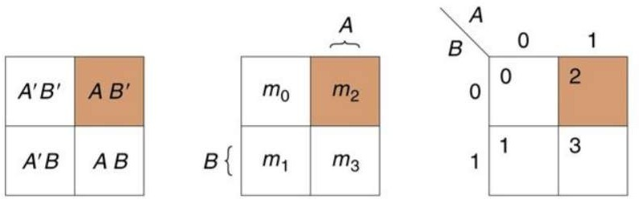
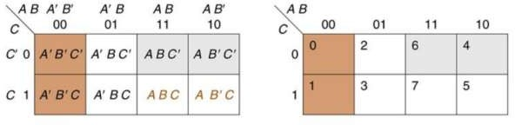
Computer System Architecture COMP201TH
Lecture-6
Implicants, Prime Implicants, Essential Prime Implicants
From the last lecture, we know; K map for 2, 3 and 4-variables is:
2-variable K Map
3-variable K Map

Slide 2
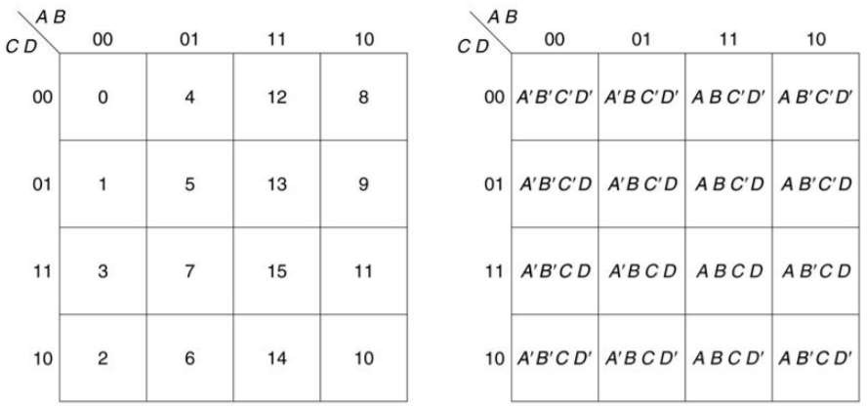
4-variable K map
Covering of a function:
o A switching function f(x1,x2,....xn) is said to cover g(x1,x2,....xn) denoted by “f is superset of g” if f assumes true value whenever g does.
Whenever g is 1, f is also
1 i.e. f is having true value whenever g is true.
f g
{0,1} ⊇ {1}
Here f contains minterm0 and minterm1.
So, we can say:
f covers g
 | g | f
0 | 0 | 1
1 | 1 | 1
2 | 0 | 0
3 | 0 | 0
If g has x minterms and g is a function of n variables, then number of
covering functions for g is
2^{n}-x
2

Slide 3
Implicant:
  A group of one or more 1’s which are adjacent and can be combined on a Karnaugh Map is called an implicant.
    i.e. in this we include group of 1 1’s, 2 1’s, 4 1’s, 8 1’s, 16 1’s.....2^{n} 1’s i.e. while grouping 1’s we group them in power of 2 and if single 1 is left then its also taken as a group.
  From the point of view of the map, an implicant is a rectangle of 1,2,4,8,... 2^{n} 1’s.
  In other words, an implicant is a product term that can cover minterms of a function.
Prime Implicant:
  Largest possible group of 1’s. In other words, the biggest group of 1’s which can be circled to cover a given 1 is called a prime implicant.
  To find prime implicants, we use all possible groups formed in K- map.
    A minimal solution will never contain non-prime implicants.
Essential Prime Implicant:
  prime implicant in which at least there is single 1 which cannot be combined in any other way.
    Essential prime implicants are those implicants which always appear in final solution.
  These are those groups which cover at least one minterm that can’t be covered by any other prime implicant.
Non Essential Prime Implicants:
  A prime implicant in which all of its covered 1 squares are covered by one or more other prime implicants.
  i.e. a prime implicant where every one of its squares is part of
another prime implicant.
Why do we need all these implicants?
While finding minimum SOP expressions from K map the only product term we need to care about are prime implicants.
Essential prime implicants are the prime implicants that must be used in any min SOP expression. It may have non-essential prime implicants only if the essential prime implicants don’t cover all squares.
There can be more than one simplified SOP due to the selection of non- essential prime implicants.

Slide 4
Procedure for finding the SOP form a K Map:
Step 1: Form the 2-,3-, or 4- variable K map as appropriate for the Boolean function.
Step 2: Identify all essential prime implicants for 1s in the K map.
Step 3: Identify non-essential prime implicants for 1s in the K map.
Step 4: For each essential and one selected non-essential prime implicant from each set, determine the corresponding product term.
Step 5: Form a sum-of-products with all product terms from previous steps.
Examples:

Slide 5
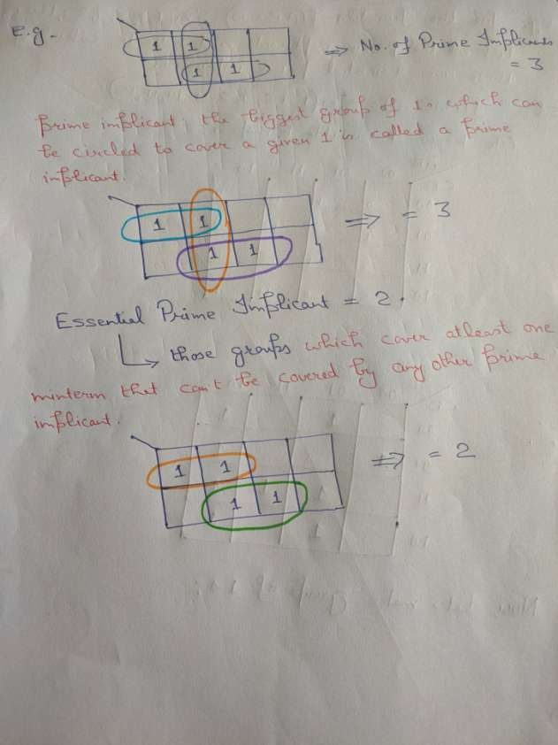

Slide 6
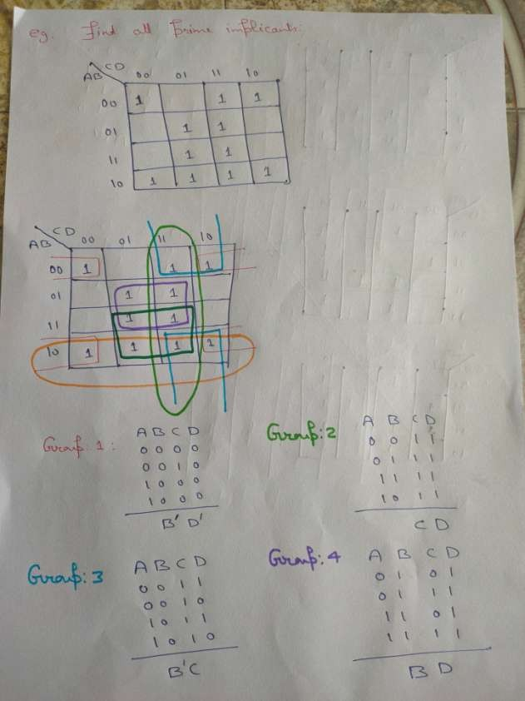

Slide 7
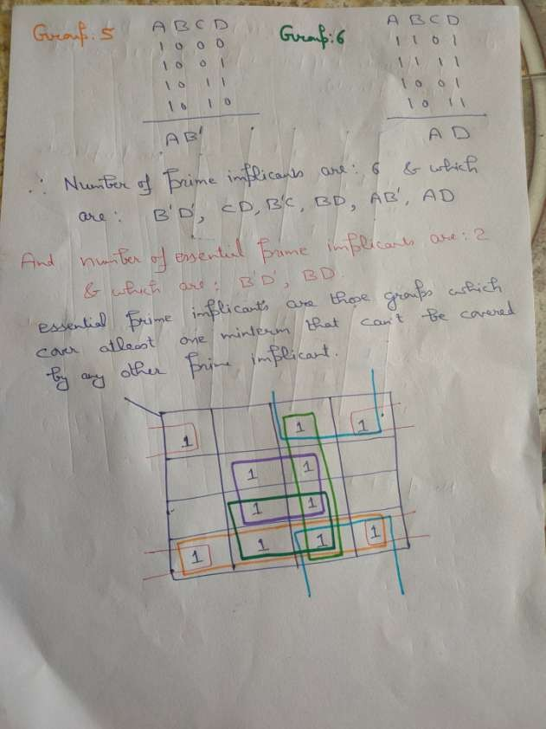

Slide 8
